Slide 1

Introduction to Creative Commons licensing
Glenda Cox
2017

Slide 2
Definition of copyright
A collection of exclusive rights, given to creators and authors to protect their original works

Slide 3
Meaning of Terms
What can be copyrighted? – Any work which is not an exact copy of someone else’s work
Can ideas be copyrighted? No… only expression of ideas are copyrighted...
Can copyright be transferred? Yes, an author can assign copyright to another person, as in the case of property

Slide 4



All rights reserved
May not reproduce
Fair use / Fair dealing for classroom use
Permission / royalty payments for reproduction
May not use on the Internet

Slide 5
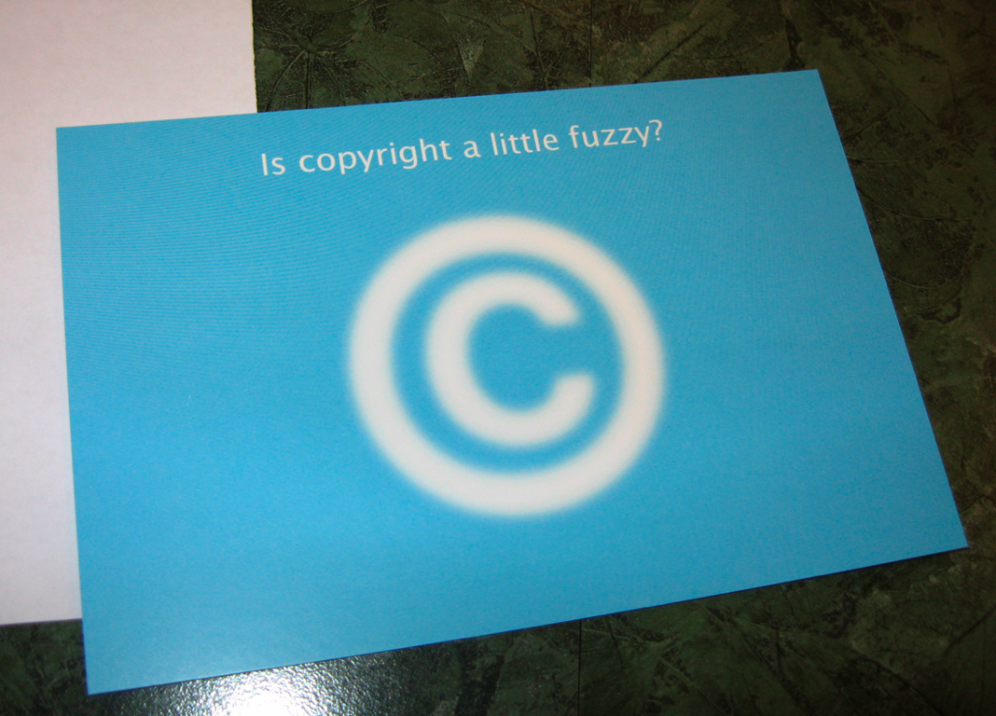
Notes:
We work to do this because it’s not always so easy, legal, or scalable when it comes to copyright law, which governs how you can share copies of content both on and offline.

Slide 6
The problem:
Traditional © designed for old distribution models
Notes:
There is a growing problem which you may already be aware of – the fact that copyright law is having trouble keeping up with technological change, especially with a technological advancement called the Internet.
Today more than ever before we can share copies of materials, whether they are textbooks, songs, videos, or emails, with the click of a button. But the law, which was designed before this was possible, says most of this is pretty much illegal unless you ask for express permission each and every time.

Slide 7
Alternative copyright licensing
Previously copyright was binary: All rights retained or public domain
Now alternative licensing options such as the GNU General Public License and Creative Commons provide a range of options where some rights are reserved
Public Domain |  | Copyright©
Public Domain | Some rights reserved | Copyright©
Notes:
One of the key initiatives enabling the legal sharing and re-working of materials has been the development of alternative licensing systems. Previously copyright was binary: All rights retained or public domain. Now alternative licensing options such as the GNU General Public License (http://www.gnu.org/licenses/gpl.html) and Creative Commons provide a range of options where some rights are reserved.
7

Slide 8
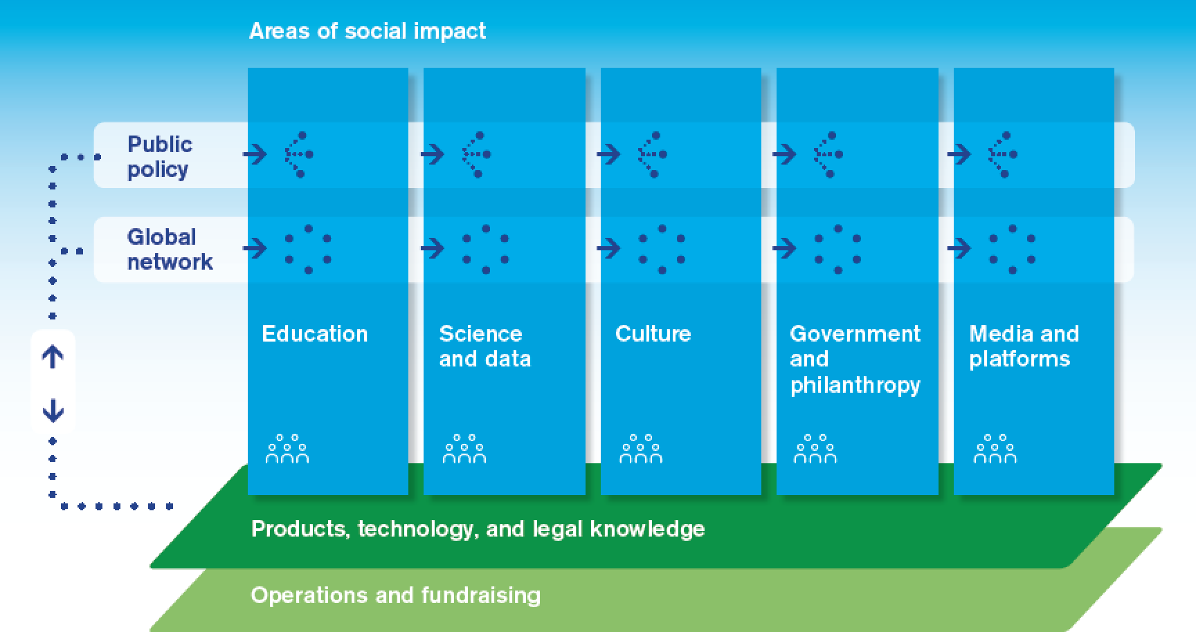

What is Creative Commons?
Creative Commons is a nonprofit that enables the sharing and use of creativity and knowledge through free technologies and licenses.
Develops, supports, & stewards legal and technical infrastructure that maximizes digital creativity, sharing, & innovation.
Our vision is nothing less than realizing the full potential of the Internet – universal access to research, education, & full participation in culture, driving a new era of development, growth, & productivity.
http://creativecommons.org/about
Notes:
Paul Stacey
Creative Commons
web site: http://creativecommons.org
e-mail: pstacey@creativecommons.org
blog: http://edtechfrontier.com
presentation slides: http://www.slideshare.net/Paul_Stacey

Slide 9
In 2015 over 1 billion works were licenced under Creative Commons
Notes:
https://stateof.creativecommons.org/report/

Slide 10
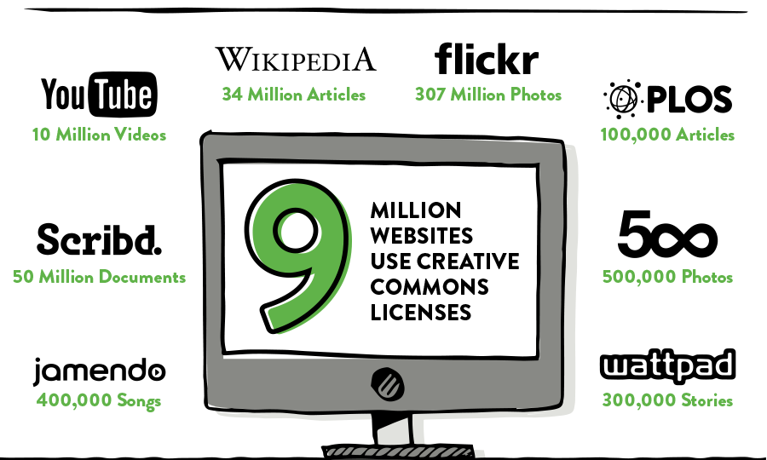
Notes:
https://stateof.creativecommons.org/

Slide 11




Creative Commons licenses
Attribution
Attribution - ShareAlike
Attribution - NoDerivs
Attribution - NonCommercial
Attribution - NonCommercial - ShareAlike
Attribution - NonCommercial - NoDerivs
*CC0 (public domain dedication)
Notes:
Paul Stacey
Creative Commons
web site: http://creativecommons.org
e-mail: pstacey@creativecommons.org
blog: http://edtechfrontier.com
presentation slides: http://www.slideshare.net/Paul_Stacey

Slide 12





Creators have choice
Some rights reserved but sharing made easy and legal.
Notes:
Paul Stacey
Creative Commons
web site: http://creativecommons.org
e-mail: pstacey@creativecommons.org
blog: http://edtechfrontier.com
presentation slides: http://www.slideshare.net/Paul_Stacey

Slide 13
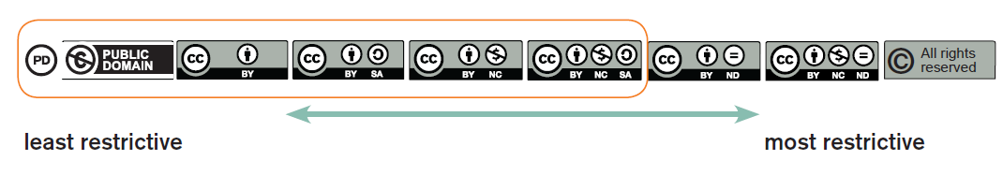
Summary - Open Licenses

Slide 14
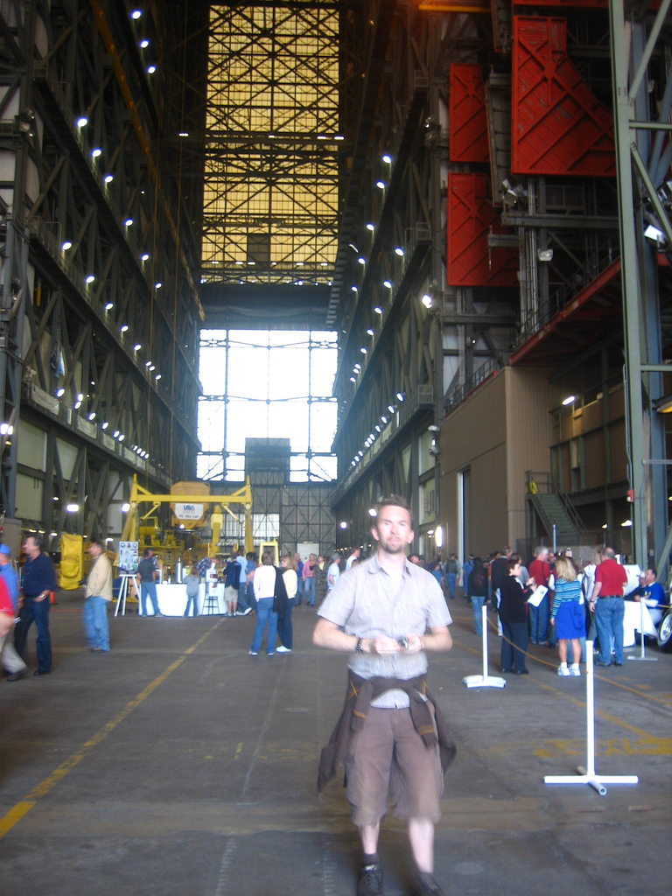
Work posted on Flickr under Attribution license

Slide 15
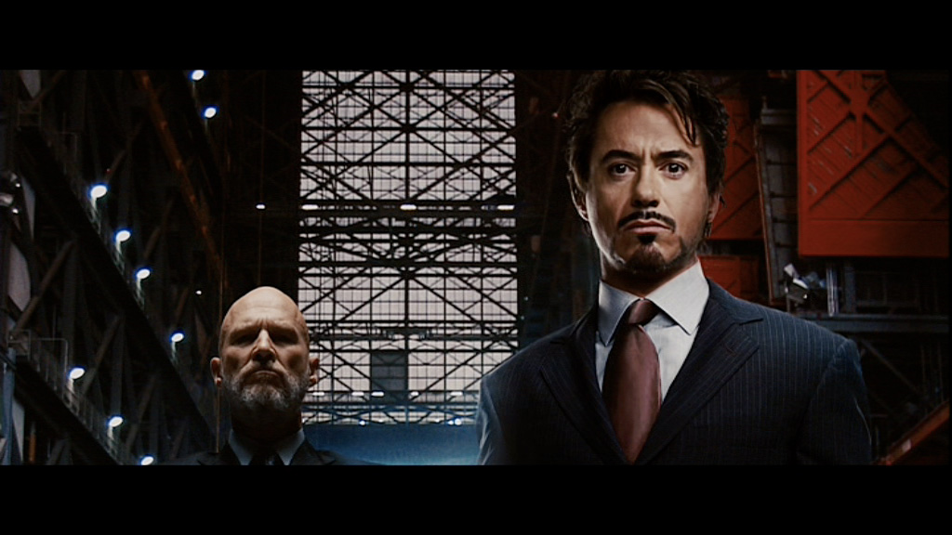

Used in The Iron Man feature film

Slide 16
Evaluating the media resources within your resource
  If resource falls under copyright protection, either:
    Recreate the resources using office or online tools
    Replace the resource with a similar resource by finding an open source alternative or by creating your own resource
    Obtain permission from the author, publisher, editor, organization who holds the copyright
    Reconsider if the resource is really necessary
Notes:
16
Once we have identified something we would like to share, we need to scrutinize it for any potential third party copyright considerations. This is the least fun part of the process! Remember that textual quotes or references from scholarly materials are ok to include as long as you reference properly. The problem is usually media, images, charts, graphs, etc.
Often we create materials that use other’s content simply because we found it online – remember online does not necessarily mean open!
If you have used content which you do not have the right to share openly, you have three options:
Replace the resource with an openly licensed alternative
Obtain permission from the publisher, author, or organization that holds copyright (we have seen this work!)
If all else fails – reconsider using the material at all

Slide 17
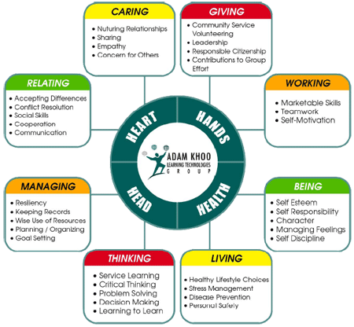
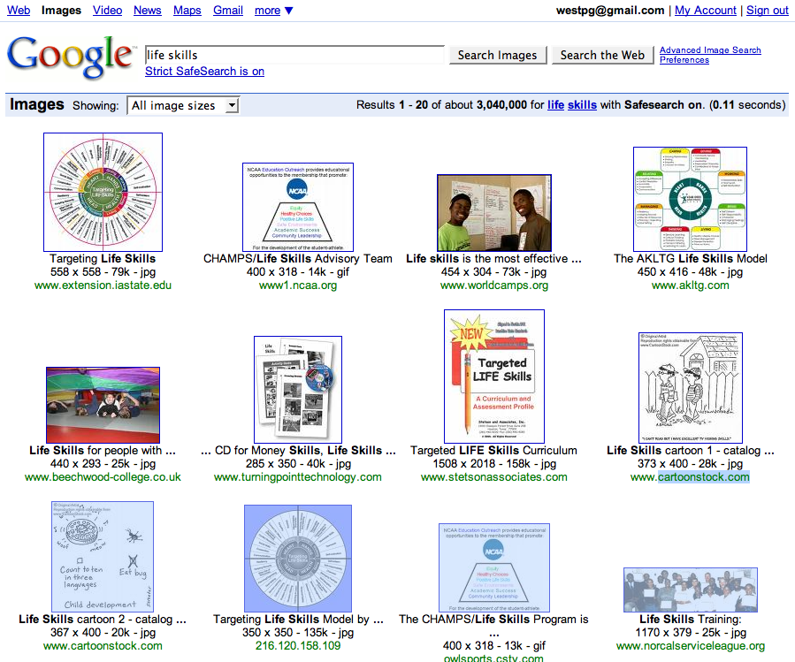
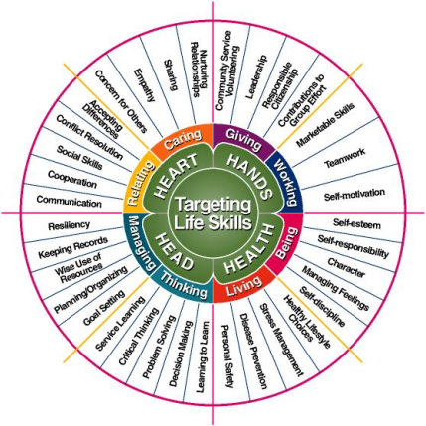
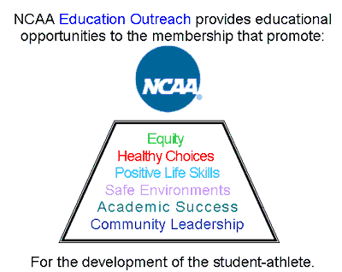
Take care to check
Copyright of
  pictures
  graphics
  texts
Understand the rights of copyright holders

Slide 18


House of Knowledge Variation1 by Adrien Sifre CC BY-NC-ND
Best Practices for Attribution: (TASL)
Title
Author
Source – Link to work
License – Name + Link
Notes:
It’s up to you where you want to give attribution, but wherever you include it, we recommend including the following pieces of information.
So we have a detailed best practices for attribution guide with examples by medium.
But if you need a quick acronym to reference, we recommend using “TASL”– which stands for Title Author Source License.
TASL is even used with elementary aged children because it’s so easy to remember.
Title and Author are self-explanatory.
Source means link to the original work where you accessed it on the web;
and License means the name of and link to the license, for example CC BY or Creative Commons Attribution, and a link to the license as specified in your SGA.
The link is very important because that’s how people who don’t know what Creative Commons is know what they can and can’t do with a work.

Slide 19
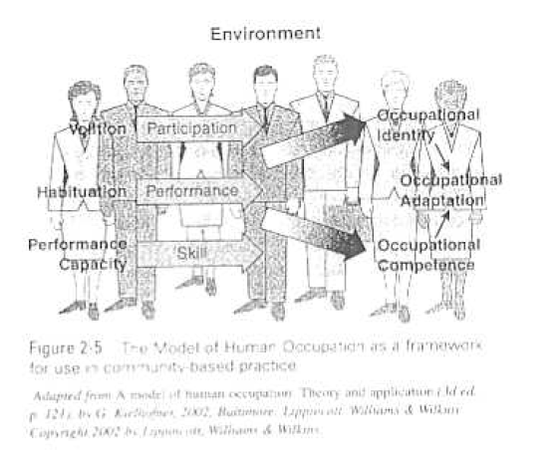
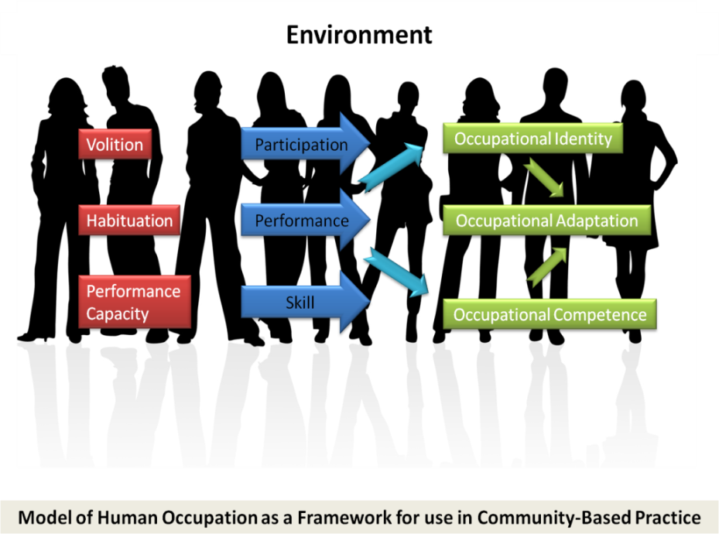
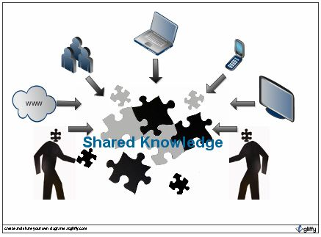
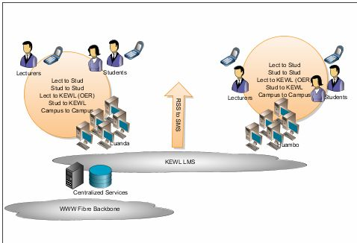
Recreating Images
http://google.com/docs
http://www.gliffy.com/
Notes:
Copyrighted diagrams and charts can be recreated using popular office applications such as PowerPoint, Excel, or Word. This also allows the craetor to put their own spin on the media – maybe even making it better and improving their thinking about it
GoogleDocs and Gliffy are online diagram creation tools which are free and easy to use for diagram creation.
19

Slide 20
Licensing your work is easy. No registration is required.
You simply add a notice that your work is under CC BY.
Here’s how you do that →
Notes:
There is no registration process to CC license something. You simply have to add a notice to your work that it is under CC BY.
And we’ve made it easy for you to do so through a tool we have developed..

Slide 21
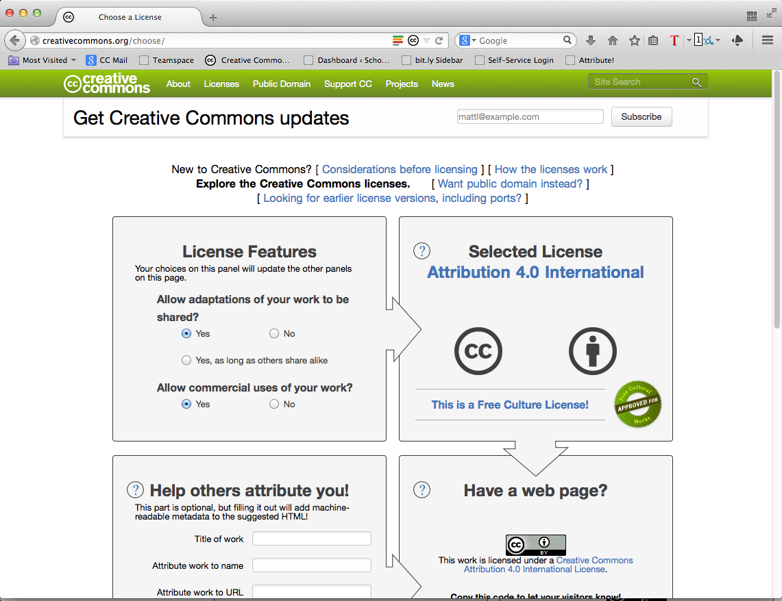
http://creativecommons.org/choose
Notes:
If you go to this web address, you’ll land on our license chooser tool.

Slide 22
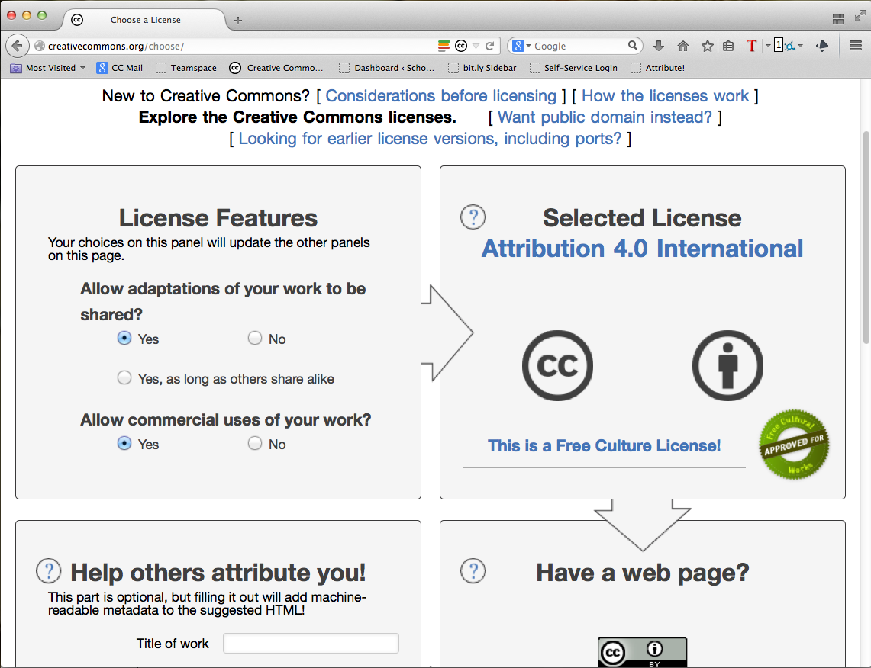
Notes:
The first box asks you what permissions you want to allow. Because you already know what license you want to use, you don’t have to change anything here. The default license chosen is the CC BY license.
One thing you might notice for the more detail oriented among you is that the default license is 4.0, whereas the SGA specifies CC BY 3.0.
4.0 is simply the upgraded version of the same CC BY license. You only have to worry about this if you want to…

Slide 23
Notes:
Just click on the link that reads “Looking for earlier license versions..” and it will take you to the 3.0 version of CC BY.

Slide 24
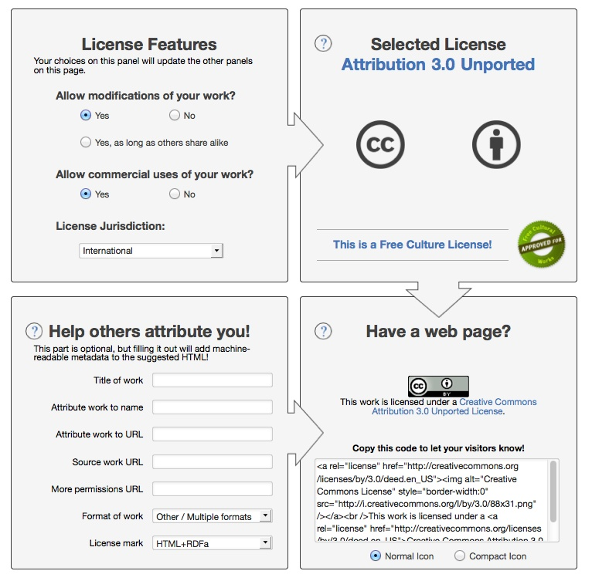
Notes:
Regardless of whether you choose 3.0 or 4.0, remember that you don’t have to change the first box because the default setting will always be CC BY for both versions.
This means that you want to leave it at “Yes” for the two questions in the first box, so:
Yes – to allow modifications, since the CC By license allows modifications.
Yes – to allow commercial uses, since the CC BY license allows commercial uses.
Ignore the License jurisdiction field because the default setting – international – is the one you want. International is the same as unported; it is the license specified in the SGA.
To the right you’ll see that you’ve selected the CC BY license without having to do anything!
Then follow the arrow to the bottom, where it says Have a web page?
And that’s where the automatic machine-readable code is that we mentioned earlier as part of the 3 layer license design. It’s there for you to copy and paste. On the webpage where you will be hosting your materials, copy and paste this code into the page’s editing interface. If you have no idea how to do this, don’t worry – you’re probably not going to be the one in charge of editing your project’s website. Simply send the person who will be in charge of that to this tool.
If they have any questions, myself and others on the Creative Commons team will work with them directly to get it on your website.

Slide 25
<a rel="license" href="http://creativecommons.org/licenses/by/3.0/"><img alt="Creative Commons License" style="border-width:0" src="http://i.creativecommons.org/l/by/3.0/88x31.png" /></a><br />This work is licensed under a <a rel="license" href="http://creativecommons.org/licenses/by/3.0/">Creative Commons Attribution 3.0 Unported License</a>.v
________________________________________________________
This workCreative Commons Attribution 3.0 Unported License.
Notes:
Once you copy and paste the code into your web page, the page will automatically display this CC BY license symbol and text. The license symbol and text are automatically hyperlinked to the license deed that I showed you earlier.
Now, you can see here that the language is pretty generic – “this work is licensed under a …”
You can always change that up if you want to reflect the specifics of your consortium or college.

Slide 26
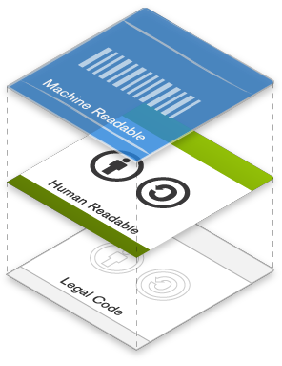
Legal and Technical
Legal Code, Human Readable Deed, Meta-Data
http://creativecommons.org/licenses/
Notes:
Paul Stacey
Creative Commons
web site: http://creativecommons.org
e-mail: pstacey@creativecommons.org
blog: http://edtechfrontier.com
presentation slides: http://www.slideshare.net/Paul_Stacey

Slide 27
You can edit the text for your specific project.
Go back to:
http://creativecommons.org/choose
Notes:
To do that, you would just go back to the chooser tool,

Slide 28
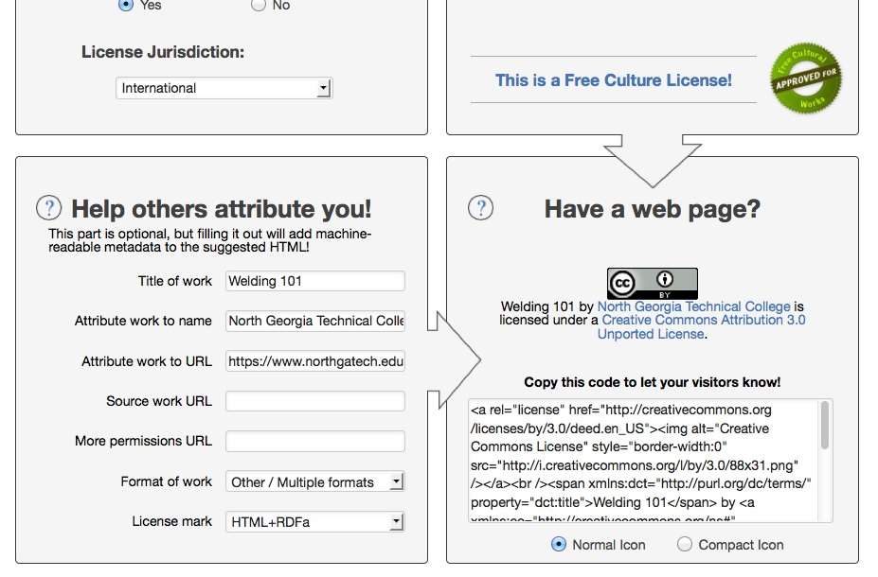
Optional fields
Notes:
And fill out the fields in the lower left box.
The fields in this box are optional. I would only worry about the first three fields if you want to add the author or owner of the work which is usually going to be your consortium or college.
I filled out the first three fields with a made-up example for you to see. So the title of my work is Welding 101, and the creator is North Georgia Technical College and the URL where the work sits is northgeorgiatech.edu…

Slide 29
<a rel="license" href="http://creativecommons.org/licenses/by/3.0/deed.en_US"><img alt="Creative Commons License" style="border-width:0" src="http://i.creativecommons.org/l/by/3.0/88x31.png" /></a><br /><span xmlns:dct="http://purl.org/dc/terms/" property="dct:title">Welding 101</span> by <a xmlns:cc="http://creativecommons.org/ns#" href="https://www.northgatech.edu/" property="cc:attributionName" rel="cc:attributionURL">North Georgia Technical College</a> is licensed under a <a rel="license" href="http://creativecommons.org/licenses/by/3.0/deed.en_US">Creative Commons Attribution 3.0 Unported License</a>.
_______________________________________________________________
Welding 101 by North Georgia Technical College is licensed under a Creative Commons Attribution 3.0 Unported License.
Notes:
The code automatically changes based on what you put in those fields, so here you can see that the the language changed to “Welding 101 by…”

Slide 30
What if I want to add the notice to a document?
Go back to:
http://creativecommons.org/choose
Notes:
Now what if you want to add a CC BY license notice to a non-web page document? For example a flyer or a booklet?

Slide 31
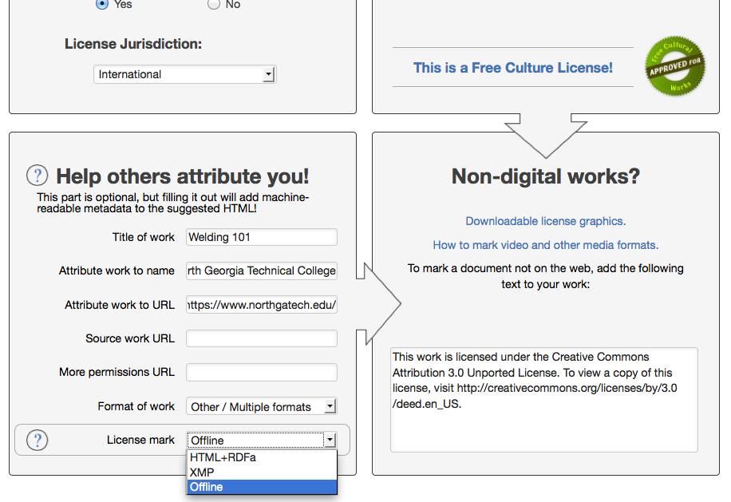
Notes:
The chooser tool allows for this also. In the last field called License mark, click the “offline” option in the drop-down menu.
You will see that the code on the right changes to plain text which you can also copy and paste into your document.

Slide 32
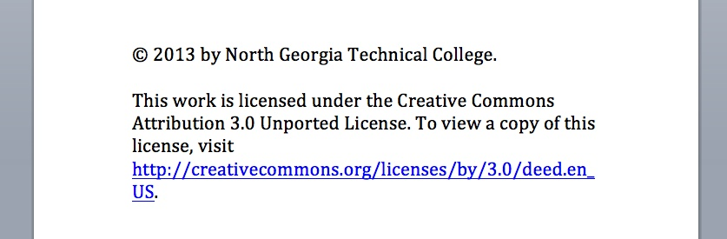
Paste where you usually put CC info
Notes:
You will copy and paste that text into your document wherever you usually put the copyright information. So here’s an example of that here. You can see that the text reads, “This work…”

Slide 33
Practice exercise:
http://opencontent.org/game/
Attribution:
See Paul Stacey’s OER presentations at http://www.slideshare.net/pstacey
Thanks to Shihaam Shaikh for examples of adapting images
Thanks to Ramesh Sharma for slides on copyright

